Slide 1

Train the Trainer Workshop October 2016

Slide 2
Aim of course
To provide new trainers with guidance and tips for developing and delivering training in bioinformatics, exploring a range of methods appropriate to different learning styles, examining the requirements for a successful course and acquiring appropriate feedback.
The workshop will:
provide guidance on general training techniques and appropriate use of methods based on learner needs, including some general do’s and do not’s for successful training
provide a framework for successful curriculum design and further development, to enable trainers to build training appropriate to their learner’s needs

Slide 3
Learning outcomes
By the end of this workshop, trainers should be able to:
Recognise the elements of good and bad training
Describe the role they play in providing an engaging and comfortable learning environment for their trainees
Construct appropriate session / curriculum design for their target audience
Explore ideas and inspiration for developing training materials and apply these appropriately
Seek and act upon feedback to improve their training through reflective practice

Slide 4
Overview - Principles of good training
What makes good and bad training?
What makes a good trainer?
How do people learn?
What methods work well for learning?
Designing a training session - learning aims and objectives.
Developing training materials (and finding them!)
Feedback / assessment - how to get it, what to do with it
Summary of day 1

Slide 5
About you….
What is your prior experience of delivering teaching / training?
What are your expectations for this workshop?
Notes:
Use this as a brief discussion at the beginning – include the trainers in this discussion, in fact you could start with the trainers.
Only needs to be a couple of lines on:
who they are
what they currently do
What training they do / have done / will do
Ask them to write their expectations onto a post it (or post-its); put them on the wall and then come back to them at the end of the day.
Do a quick summary of the post-its before you start; this gives a chance to indicate where in the session there will be opportunity to discuss the issues they have raised. Its also good for the participants to see how similar the issues of concern might be between them all.

Slide 6
Session 1: Good vs bad training and trainers

Slide 7
Training you have been involved in….
What makes a good training session ?
What makes a bad training session ?
Think of an example of each that you have participated in and list your thoughts…
Notes:
Run as a group activity - small groups eg 4 per group at most
Two sets of post its per group - “Good” and “bad” – ask them to write one point per post it.
Bring all groups post-its together and sort for “consensus” – where there are the same points raised, post them together.
Try to get the group to move to a single point in the room for this discussion, away from their desks if possible.
Brief discussion as whole group on the good and bad points raised – ask groups to illustrate examples where possible. Trainers can also bring in their own examples of good or bad practice.

Slide 8
What makes a good trainer ?
Knowledge of subject
Clear aims for session outcomes
Confidence in delivery
Appropriate delivery
Listens to trainees
Flexible – can change pace / depth if required
Approachable
Engaging
Notes:
Throw question out to group - reiterates the findings from the good and bad examples;
What in their opinion makes a good trainer (list is hidden, animated to show full list once some suggestions have been provided by the group)

Slide 9
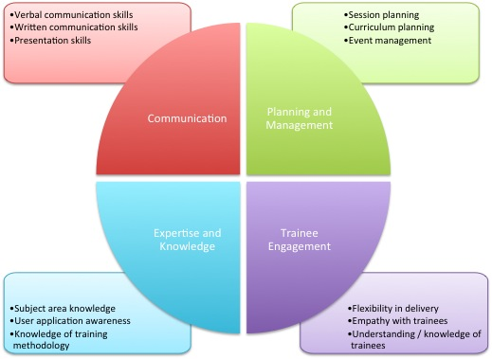
Goblet TTT matrix
Notes:
This matrix developed by goblet TTT taskforces - aims to provide an overview of the major skills required to be a good trainer; note that not all trainers will have all skills - that is note the point! This can be circulated in advance so they can reflect on their current skills and how they fit with this matrix. A more detailed version with explanation can be provided during the session.

Slide 10
How do people learn ?
How do you go about learning something new ?
Read about it
Attend a training session !
Have a go ?
Do, reflect, process, further understand ?
Notes:
Throw this out just to get them thinking before moving on to the next session – this is a good point to have a break.

Slide 11
Session 2: How do people learn?
Notes:
Now the focus is on trainees and how to engage them in the learning process.

Slide 12





How do you approach learning new things?
Notes:
Google, lit search, experiment, textbook, online course, youtube,”have a go”
Ask around the room – how do they approach things?

Slide 13
Experiential learning: Kolb’s cycle
Kolb learning cycle :
Concrete
experience
Active
experimentation
Reflective
observation
Abstract
conceptualisation
Notes:
Kolb learning cycle - from 1984
Four stage cycle - internal cognitive processing of learner.
Don’t worry about going into too much detail here - will find reference

Slide 14
Kolb’s cycle in detail
Concrete experience – be involved in a new experience
Reflective observation – reflect on your experiences, potentially with feedback from others
Abstract conceptualisation – form and reform your ideas, integrate into theory
Active experimentation – make decisions and problem solve
Notes:
Must remember that learners already have some knowledge, so building upon what they already have in their mind.

Slide 15
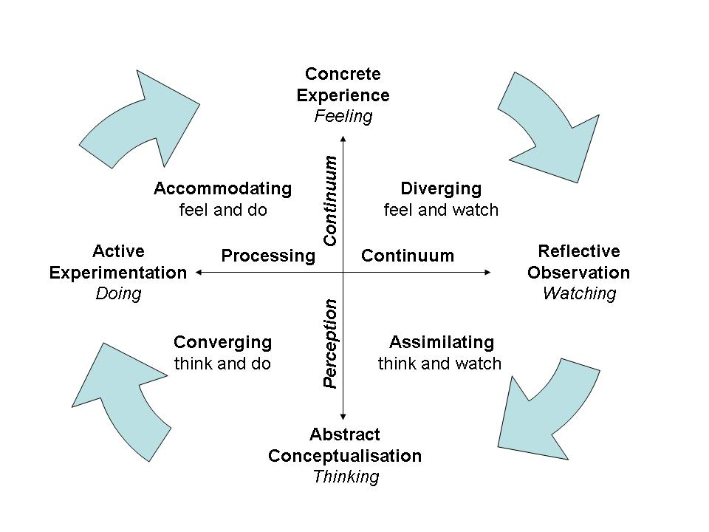
Kolb expanded – learning styles

Slide 16
Individual learning styles
Different people will have different ways of learning
How do you think you learn?
Complete a learning styles questionnaire
Notes:
Questionnaire - allow 10 minutes for completion
Collect learning styles from around the room
Collect the styles on a flipachart or whiteboard so everyone can see them

Slide 17
Learning styles relating to Kolb
Honey and Mumford, 1986
Four main categories of learning style
Activist – challenges, new experiences and problems, excitement and freedom
Pragmatist – Practically based, immediately relevant learning activities, scope for practice and using theory
Reflector – structured learning activities with time to observe, reflect and think
Theorist – logical, rational structure and clear aims – time for methodical exploration
Notes:
Give explanations of the learning styles - ask how people feel this fits with their view of themselves

Slide 18
Learning “activities”
Different learning styles work with different activities
What activities / methods can you list as a group?
Can you subtype these by related learning style?
Notes:
Small groups as before, but use different groupings
Post-its, one method per post-it
Group them together and discuss as a whole group
On-course toolkit for trainers - https://www.on-course.eu/toolkit/

Slide 19
What activities different styles relate to
Activist | Brainstorming, problem solving, group discussion, puzzles, competitions, role-play
Theorist | Models, statistics, stories, quotes, background information, applying theories
Reflector | Paired discussions, self analysis questionnaires, personality questionnaires, time out, observing activities, feedback from others, coaching, interviews
Pragmatist | Time to think about how to apply learning in reality, case studies, problem solving, discussion

Slide 20
How to apply these ?
No chance of running a questionnaire at the beginning!
Must consider that you will have a mix of styles in your group, so need to provide learning materials / activities that will apply to many
Notes:
Remember that your group will always be mixed - in how they approach their learning, their previous experience, their depth of knowledge and confidence with what they are trying to do.
Consider running some exercises early on in the course to get people talking and indicating where they are in their knowledge etc.
Make your learning space a comfortable one! Whether people like working in groups / alone / talk or not talk; need to make people feel comfortable and get the support they need.

Slide 21
Learning activities
Main thing to remember:
People can only concentrate for short periods – often 15 – 20 minutes at most, before it drops
For lecture sessions – intersperse with activities eg questions, short problems, discussion points
For practical sessions – check on where the group as a whole is, or have demonstrators who can move around the room
Notes:
Death by powerpoint comment !

Slide 22
Most people learn……
10% of what they read
20% of what they hear
30% of what they see
50% of what they see and hear
70% of what they talk over with others
80% of what they use and do in real life
95% of what they teach someone else

Slide 23
Session 3 : Session and course design

Slide 24
Session design
Where to start ?
What do you need to know?
Notes:
5 minute group discussion and report back

Slide 25
Target audience
This may or may not be your choice !
Consider what background knowledge the trainees may have, what they are currently doing.
At this point may want to start to think about pre-requisite knowledge
Eg Undergraduate level biology

Slide 26
Session aim
What is it that you are trying to provide through this session? What subject matter is to be covered?
How does this fit with the overall course aim (if applicable)
May be to teach people a particular analytical method, or to introduce people to a new resource.
Clear aim will help when setting curriculum in more detail.
Leads into Learning Outcomes
What do you want your trainees to do at the end?

Slide 27
Learning outcomes Should be SMART
Specific
Measurable
Achievable
Realistic
Time-limited
What ?
By trainee / trainer or both ?
Is it possible in this context ?
Can we really train them to do this ?
In what time ?
Notes:
Ask what they know about learning objectives - if anything!

Slide 28
Levels of learning – Blooms taxonomy
5 Evaluation
6 Synthesis
4 Analysis
3 Application
2 Comprehension
1 Knowledge
Notes:
Depth of learning you want them to achieve - knowledge is the “surface”; synthesis is the deepest level

Slide 29
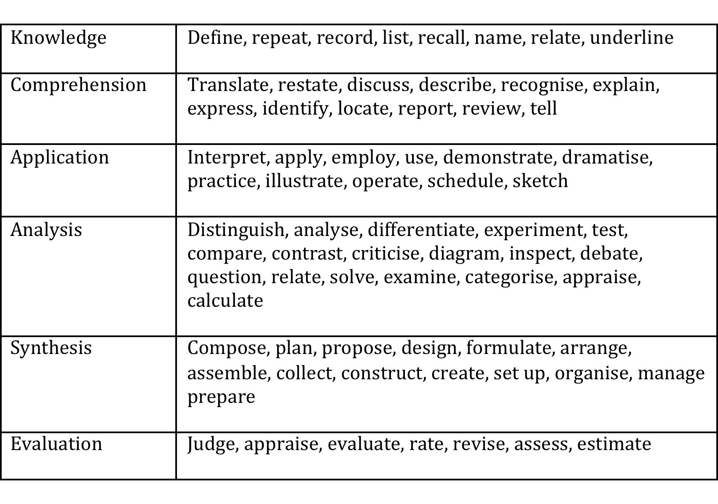
From taxonomy to verbs…
Notes:
LO activity - in small groups, define an aim and learning objectives for a topic of their choice; 10 minutes discussion; feedback to whole group for comment.

Slide 30
Curriculum planning
No one set way of doing this – but if LO’s are set, then expand from these
What are the major themes which can be identified under your major course topic?
Which of these will you cover (can you cover all?)
Need to consider depth of learning
Think about balance of practice and theory
Also consider competency frameworks eg ISCB – what are the particular skills / knowledge they need from your session?
Notes:
Which can you cover - time and resources?
Also think about using competency based frameworks

Slide 31
Developing materials
How do you build a new set of materials?
Consider setting up a new session which requires both tutorial and practical elements.
Notes:
Small group discussion - How would they approach this
What challenges faced in doing so previously.
- Discussion aims, LOs, pre-requisite info, level of detail needed, other useful reference points extra reading etc.

Slide 32
Developing materials (2)
Do you always need to develop from new?
Where can you find materials - for use or inspiration?
Can materials easily be re-used?
Notes:
Small group discussions.
Discussion on where materials can be found - eg colleagues, GOBLET, other sources?
Discussion about material descriptions / annotation for re-use
Challenges in re-using - could someone else use your material? How can you describe your materials for re-use?

Slide 33
Session 4: Feedback

Slide 34
Whilst running a session - real-time feedback
Do keep an eye on your “audience”
Watch for signs that they don’t understand, or concentration is lapsing
Try and be flexible – adapting your session to suit the group as you go if possible
How can you assess where your trainees are during your session /course?
Practicals – can be useful to have someone at the back of the room !
Notes:
Assessing trainee progress - small discussion; methods for keeping track as you go through your session eg instant feedback, 5 fingers, software carpentry post-its, electronic polls, quizzes

Slide 35
Reflective practice
After you have completed a session:
Think about what worked well and what you were not happy with
Helps you when planning future sessions, whether the same or a different one
Don’t be too negative – remember groups vary (do think about the environment etc)
Where does you feedback come from?
Self, the room, colleagues and end of course survey

Slide 36
Post-course collection of feedback
Feedback from trainees can be very useful
Keep surveys short
Think about your reasons for collecting the information and what you need to collect
Mixture of closed and open questions
Think about who will have access to the results – do you need to moderate?
You should always review your feedback along with your own reflections
Notes:
Discussion - what might you ask and how would you use it?

Slide 37
End of day 1

Slide 38
Preparation for tomorrow
Prepare a three minute presentation on a topic of your choice
Aim for the presentation and one learning outcome (this should be one of the first things you tell us).
You can present in any format you wish.
Be prepared to deliver this to a small group and to the whole group.
Be prepared to both give and receive feedback and act upon it.

Slide 39
Day 2 : Putting the principles into practice

Slide 40
Your challenges today
Deliver a short session and act on feedback provided.
Expand a session idea up to a longer session
Consider the practical aspects of running this session - design a trainer checklist

Slide 41
Challenge 1 - am
You will be split into groups of 3
Make sure your group has a laptop and a phone which can record video
You need to each deliver your 3 minute session to the others
One person delivers the session
One person records on the phone
One person notes down comments real-time
You then provide feedback to each individual, and give your own comment on your delivery
You then have time to revise your session, before delivering to the whole group.

Slide 42
Challenge 2 - pm
In your group…
Take one session idea and expand to a “real” training session
You will need to:
Identify target audience
Session structure (include indicative content, length, breakdown and timings)
Learning objectives
Learning activities
Suggest how you will assess trainee progress
Tell us anything else you think we need to know….
Deliver a 5 minute presentation on your session - sell it to us!

Slide 43
Challenge 3 - pm
Based on your session design, write a trainer checklist listing all requirements / considerations to run this session
What resources do you need?
What environment do you want to teach in?
What support / help do you need onsite?
Write individual elements on post-its - we’ll then post up together and discuss.
Notes:
Software and operating systems, stationery, computers / own laptops?, teaching assistants, local vs virtual, Printing of materials?, datasets,
Support - trainers, assistants, catering…..
What if you are teaching somewhere you do not normally teach…

Slide 44
Final discussion

Slide 45
Two questions…
Have your initial expectations been met?
What one thing have you learned that you were not expecting?

Slide 47
Limitations / issues for Bioinformatics training
Fast changing subject, tools change quickly
Difficult to use a traditional training approach “click here”
Need to provide understanding of how tools work, and general idea of what is happening, so if a tool changes, trainees can still use it
Example datasets and appropriate exercises
Either difficult to get datasets, or need to use cut down sets, so not quite so true to life – teaching concepts, not full practical “how to”

Slide 48
Planning the course
Scientific and “social” elements
Scientific – in what order will you deliver the various elements of the course content
Social – coffee and lunch breaks, opportunities for networking
How long do you have to deliver the course ?
How long should your day be ?
Theory vs practice
Even in a very practical course, theoretical explanation session are helpful for scene setting

Slide 49
Commonly used sessions
Course welcome and introduction
Welcome your trainees, give any H+S details etc
Intro to course, aims and expectations
Start of day
Brief intro of what is to come, can check everyone is in, all happy
End of day
Quick recap, again check everyone is ok, good time for discussion
Final wrap-up session and feedback collection

Slide 50
Lecture – style sessions
Death by powerpoint is common !
Try to make slides more interesting if possible
Don’t necessarily put everything on the slide you are going to say – avoids you reading off your slides!
Don’t overfill your slides and use at least a 20 point font
Build time in for questions, discussions…..

Slide 51
Practical sessions
Practical handbooks important – guided exercises to follow
Can start with a demonstration, then into the guided exercise
Remember not everyone will necessarily go at the same pace
Extra time in programme for people to finish if they wish– eg lunchtimes
Have some extra exercises eg problems to solve, for those who finish
Can be difficult deciding how much time to give
Having extra demonstrators in the room to answer queries is very helpful

Slide 52
Group problem solving
Can be a good way of getting people talking, can also be a useful way of ascertaining how much people know
Eg Workflow exercise – what are the steps taken in a metagenomic workflow, potential limiting points in this etc
At the beginning can be useful to get people into the mindset, and help you set the scene for the course
You can refer back to this session at different points in the course, helping reinforce ideas
Especially useful in sessions where you have a high number of novices in the field

Slide 53
Course descriptors and advertising
Keep course descriptors concise, but consider what information people will use to choose a course.
List points to include?
Make sure it is a true representation of what you will cover, so trainee expectations can be managed / met
Advertise everywhere you can!

Slide 54
Applications
Methods of application can vary – e.g. CV and supporting letters or completion of online form
You need to decide on your selection criteria
Be transparent, so if someone queries you, they can be answered.
Make sure that you can get the information you need for selection from the information you have requested.
May decide on a selection committee - more than one person to review all applicants.

